Slide 1
Introduction
In our last class, we discussed Problem Formulation in AI, including important concepts, Search Algorithms, and applications.
We also delved into uninformed search algorithms, specifically BFS.
This week, we will continue by looking at two more types of Uninformed Search and finally discuss Informed Search Algorithms

Slide 2
Learning Outcomes
By the end of this lesson, students should be able to:
Explain the principles and operational differences among key uninformed search algorithms: Depth-First Search (DFS), Depth-Limited Search (DLS), Iterative Deepening Depth-First Search (IDDFS), Uniform Cost Search (UCS), and Bidirectional Search.
Illustrate the working process of each uninformed search algorithm using appropriate graph representations and node expansion sequences.
Implement each of the five algorithms in Python (on Google Colab), correctly using appropriate data structures such as stacks, queues, and priority queues.
Compare and analyze the performance of the algorithms in terms of completeness, optimality, time complexity, and space complexity.
Apply the algorithms to practical problem scenarios such as route finding, network traversal, and decision-tree exploration to identify suitable algorithms for different conditions.
Evaluate and justify the choice of a specific uninformed search strategy based on problem constraints such as memory limitation, search depth, or cost structure.

Slide 3
Depth-First Search (DFS)
DFS explores as far as possible along each branch of a search tree path before backtracking. It uses a stack (LIFO) and is more memory-efficient than Breadth-First Search (BFS) but does not guarantee the shortest path.
Key Features
Efficient for deep exploration.
Can get stuck in infinite loops if cycles exist
It uses a stack (LIFO) structure

Slide 4
BFS Psudocode
DFS(start, goal):
create a stack S
push start to S
create a visited set
while S is not empty:
node = S.pop()
if node == goal: return path
if node not in visited:
mark node as visited
push all unvisited neighbors of node onto S

Slide 5
Algorithm Steps
Start at the initial node and push it onto the stack.
Pop the top node.
If it’s the goal, return the solution.
Otherwise, expand the node — generate all successors.
Push all unvisited successors onto the stack.
Repeat until the stack is empty or the goal is found.
How it Works (Example)
Imagine searching for a target city in a map:
DFS goes deep along one path (e.g., Lagos → Ibadan → Ilorin → ...).
If it reaches a dead end, it backtracks to the previous city and tries another route.

Slide 6
Applications
Solving mazes or puzzles (e.g., n-Queens, Sudoku).
Pathfinding where the solution is deep but not necessarily optimal.
Topological sorting and parsing expression trees.
Web crawling and backtracking algorithms.
Let’s look at Puzzle Solving using BFS
In puzzle solving, DFS is particularly useful for exploring all possible configurations or paths in problems where the solution depth is not too large.

Slide 7
How DFS Works in Puzzle Solving
DFS is typically implemented using a stack (either explicitly or via recursion). The idea is to:
Start from an initial state (e.g., the start of the puzzle).
Generate all possible next states (moves).
Choose one possible move and continue exploring deeply along that path.
If the current path reaches an invalid or dead-end state, backtrack and try another move.
Repeat until the goal state (solution) is found.
Example Puzzle – 8-Puzzle Problem
The 8-puzzle consists of a 3×3 grid with tiles numbered 1–8 and one blank space. The goal is to move the tiles around until they are arranged in a specific order (goal state).
Initial State
1 2 3
4 0 6
7 5 8
(0 represents the blank space)

Slide 8
Goal State
1 2 3
4 5 6
7 8 0
DFS Algorithm Steps in the 8-Puzzle
Start with the initial configuration.
Push this configuration onto the stack.
Pop the top configuration and check if it’s the goal.
If not, generate all possible moves (up, down, left, right of the blank).
For each new configuration not visited before, push it onto the stack.
Repeat until the stack is empty or goal is found.

Slide 9
Benefits of BFS
Simple to implement using recursion or stack Requires less memory than BFS Can find a solution quickly if it lies deep in the tree Useful for puzzles where solution depth is known or small
Limitations
May get trapped in deep infinite paths if not managed with visited states Not guaranteed to find the shortest solution Inefficient for puzzles with very large state spaces

Slide 10
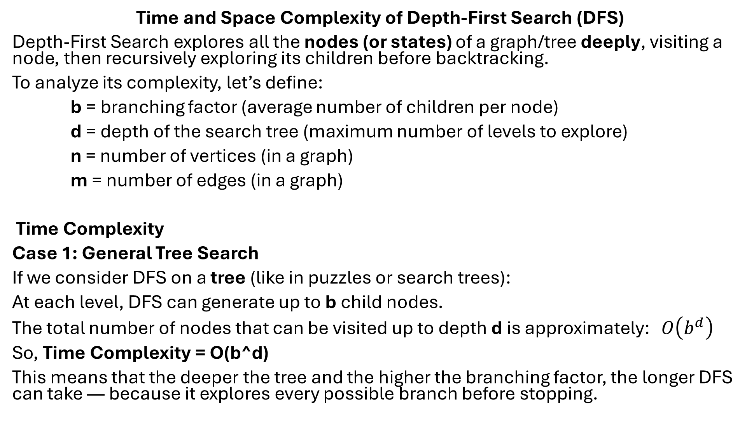
Time and Space Complexity of Depth-First Search (DFS)
Depth-First Search explores all the nodes (or states) of a graph/tree deeply, visiting a node, then recursively exploring its children before backtracking.
To analyze its complexity, let’s define:
b = branching factor (average number of children per node)
d = depth of the search tree (maximum number of levels to explore)
n = number of vertices (in a graph)
m = number of edges (in a graph)
Time Complexity
Case 1: General Tree Search
If we consider DFS on a tree (like in puzzles or search trees):
At each level, DFS can generate up to b child nodes.
The total number of nodes that can be visited up to depth d is approximately: $O\left(b^{d}\right)$
So, Time Complexity = O(b^d)
This means that the deeper the tree and the higher the branching factor, the longer DFS can take — because it explores every possible branch before stopping.

Slide 11
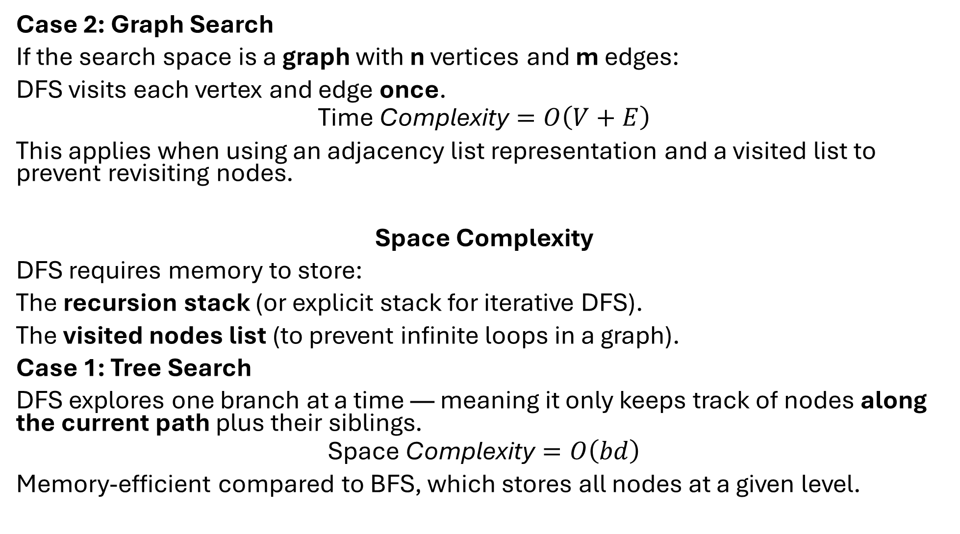
Case 2: Graph Search
If the search space is a graph with n vertices and m edges:
DFS visits each vertex and edge once.
$$\text{Time} \text{Complexity}=O\left(V+E\right)$$
This applies when using an adjacency list representation and a visited list to prevent revisiting nodes.
Space Complexity
DFS requires memory to store:
The recursion stack (or explicit stack for iterative DFS).
The visited nodes list (to prevent infinite loops in a graph).
Case 1: Tree Search
DFS explores one branch at a time — meaning it only keeps track of nodes along the current path plus their siblings.
$$\text{Space} \text{Complexity}=O\left(bd\right)$$
Memory-efficient compared to BFS, which stores all nodes at a given level.

Slide 12
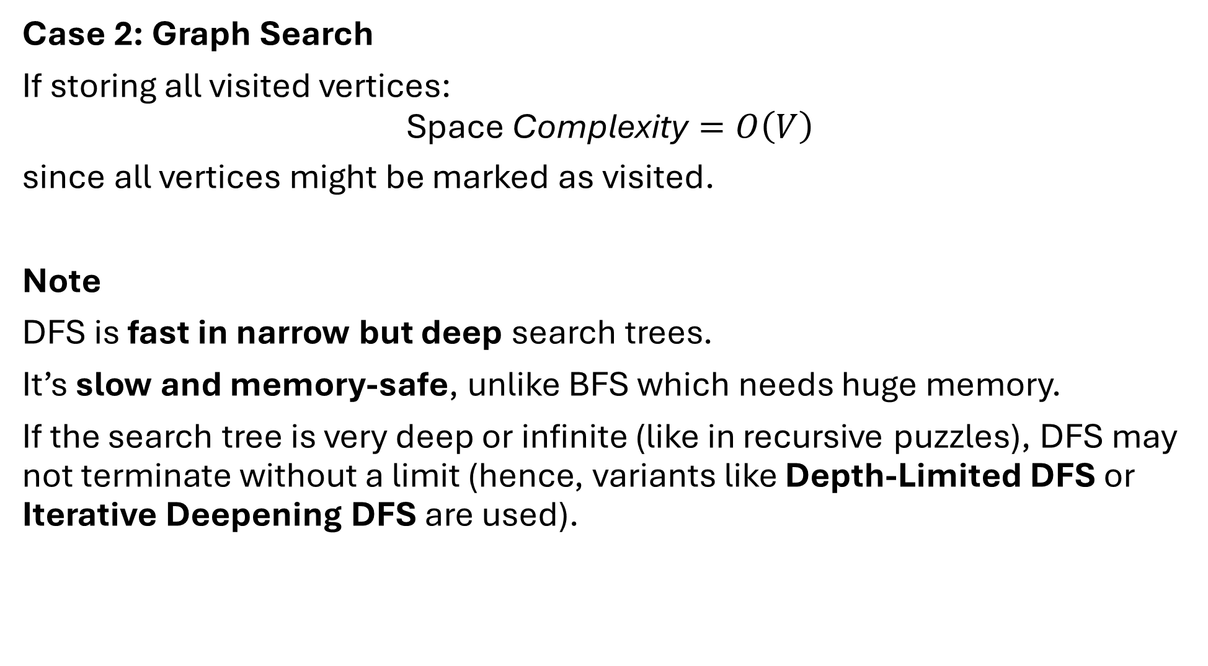
Case 2: Graph Search
If storing all visited vertices:
$$\text{Space} \text{Complexity}=O\left(V\right)$$
since all vertices might be marked as visited.
Note
DFS is fast in narrow but deep search trees.
It’s slow and memory-safe, unlike BFS which needs huge memory.
If the search tree is very deep or infinite (like in recursive puzzles), DFS may not terminate without a limit (hence, variants like Depth-Limited DFS or Iterative Deepening DFS are used).

Slide 13
Also note:
Time Complexity (Tree): O(b^d)
Time Complexity (Graph): O(V + E)
Space Complexity: O(bd) or O(V)
Is DFS optimal? No, it may not find the shortest path.
Is DFS complete? Not always, unless the search space is finite.

Slide 14
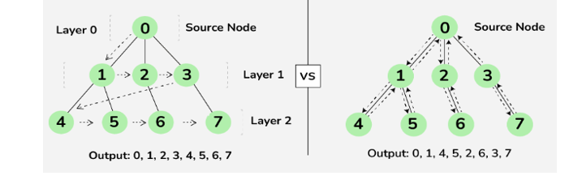
Graphical Example to illustrate the difference between BFS and DFS
BFS DFS

Slide 15
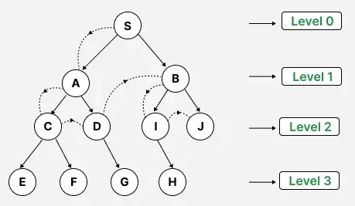
Depth Limited Search (DLS)
DLS is a modified version of DFS that limits how deep the search can go. It introduces a depth limit (L) to prevent infinite descent in deep or cyclic search spaces
This means that the algorithm will only explore nodes up to a certain depth effectively preventing it from going down excessively deep paths that may also lead to not reaching the goal and is computationally expensive.
By setting a maximum depth limit, DLS aims to improve efficiency and ensure more manageable search times.

Slide 16
How Depth Limited Search Works
Initialization: Begin at the root node with a specified depth limit.
Exploration: Traverse the tree or graph, exploring each node's children.
Depth Check: If the current depth exceeds the set limit, stop exploring that path and backtrack.
Goal Check: If the goal node is found within the depth limit, the search is successful.
Backtracking: If the search reaches the depth limit or a leaf node without finding the goal, backtrack and explore other branches.
From the graph example, our depth limit is set to L = 2, the algorithm will only explore nodes up to two levels deep. After that, it backtracks, avoiding infinite recursion.

Slide 17
Benefits
Avoids infinite loops in DFS.
Requires less memory than BFS.
Useful when the goal depth is known approximately.
Limitations
If the depth limit is too small, the algorithm fails to find the goal.
If too large, it wastes time exploring unnecessary levels.
Still not optimal (depends on the depth limit).

Slide 18
Pseudocode for DLS
def depth_limited_search(node, goal_test, limit):
if goal_test(node):
return node
elif limit == 0:
return "cutoff"
else:
cutoff_occurred = False
for child in expand(node):
result = depth_limited_search(child, goal_test, limit - 1)
if result == "cutoff":
cutoff_occurred = True
elif result != "failure":
return result
return "cutoff" if cutoff_occurred else "failure"

Slide 19
In the pseudocode,
The function takes node, goal_test and limit as inputs.
If the node satisfies the goal, it returns the node as the solution.
If the depth limit is 0, it stops and returns "cutoff" to indicate the limit was reached.
It then expands the current node to generate child nodes. For each child, it calls itself recursively with the limit decreased by 1.
If any child returns "cutoff" it marks that a cutoff happened.
If any child returns a valid result (not "failure") it returns that result immediately.
After checking all children, if any caused a cutoff, it returns "cutoff", otherwise it returns "failure" meaning no solution was found within the limit.
Notes:
So, DFS is very useful in solving problems where search depth is known or can be estimated
Useful in game trees

Slide 20
Applications of Depth Limited Search in AI
Pathfinding in Robotics: DLS is employed for nonholonomic motion planning of robots in the presence of obstacles. By imposing restriction on the depth it makes the robot stop after exploring a particular depth of an area and restricting the robot from too much wandering.
Network Routing Algorithms: A DLS can be implemented to compute paths between nodes in computer networks restricting the number of hops to prevent loops.
Puzzle Solving in AI Systems: It can be used to solve puzzles such as the 8-puzzle or Sudoku by manipulating possible moves a fixed number of times that reduces how many steps are taken in the search.
Game Playing: In AI for games, instead, DLS can be used to plan forward a few moves up to a certain level of depth to help decide how much effort to put into a given decision.
Notes:
DFS can be used for various tasks including searching for a path between two nodes, traversing a tree or graph to visit all nodes or solving certain types of puzzles. It's often used as a building block in more complex algorithms and AI applications such as solving mazes, analyzing game states or exploring decision trees in search algorithms like minimax for games like chess or tic-tac-toe.

Slide 21
Properties of DLS
Property | Depth-Limited Search (DLS) | Explanation
Completeness | No (unless limit ≥ goal depth) | Fails if the goal is deeper than the limit
Optimality | No | May find a suboptimal or longer solution
Time Complexity | O(b^ℓ) | Depends on branching factor and depth limit
Space Complexity | O(bℓ) | Linear with depth limit (memory efficient)
Notes:
DLS is not complete if the depth limit (ℓ) is less than the depth of the shallowest goal node.
It becomes complete only if the limit ℓ ≥ depth of the goal.

Slide 22
Iterative Deepening Depth-First Search (IDDFS) or IDS
IDDFS combines the benefits of BFS (completeness and optimality) and DFS (low memory use). It performs repeated Depth-Limited Searches with increasing depth limits until the goal is found.
Algorithm Steps
For depth = 0 to ∞:
Run a Depth-Limited Search with limit = depth.
If goal is found, stop and return the solution.

Slide 23
How it Works (Example)
If you’re searching for a goal:
First, search up to depth 0 → not found.
Then depth 1 → not found.
Then depth 2 → found goal. This way, it restarts DFS multiple times but ensures shallower nodes are explored first.

Slide 24
Benefits
Complete (will find a solution if it exists).
Optimal for uniform step cost (like BFS).
Uses less memory than BFS.
Avoids infinite loops like DFS.
Limitations
Some redundant exploration — re-expands nodes at each iteration.
Computationally expensive if the branching factor is high.
Not suitable when step costs vary.

Slide 25
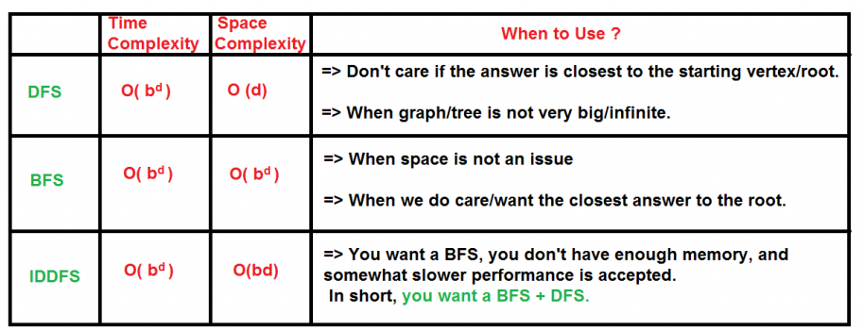
Comparison between BFS, DFS and IDS

Slide 26
Uniform Cost Search
This is a pathfinding algorithm that expands the least cost node first, ensuring that the path to the goal node has the minimum cost. Unlike other search algorithms like BFS, UCS takes into account the cost of each path, making it suitable for weighted graphs where each edge has a different cost.
Key Concepts of Uniform Cost Search
Priority Queue: UCS uses a priority queue to store nodes. The node with the lowest cumulative cost is expanded first. This ensures that the search explores the most promising paths first.
Path Cost: The cost associated with reaching a particular node from the start node. UCS calculates the cumulative cost from the start node to the current node and prioritizes nodes with lower costs.
Exploration: UCS explores nodes by expanding the least costly node first, continuing this process until the goal node is reached. The path to the goal node is guaranteed to be the least costly one.
Termination: The algorithm terminates when the goal node is expanded, ensuring that the first time the goal node is reached, the path is the optimal one.
Notes:
UCS operates under a simple principle: among all possible expansions, pick the path that has the smallest total cost from the start node. This is implemented using a priority queue to keep the partial paths in order, based on the total cost from the root node.

Slide 27
How UCS works
Initialization: UCS starts with the root node. It is added to the priority queue with a cumulative cost of zero since no steps have been taken yet.
Node Expansion: The node with the lowest path cost is removed from the priority queue. This node is then expanded, and its neighbors are explored.
Exploring Neighbors: For each neighbor of the expanded node, the algorithm calculates the total cost from the start node to the neighbor through the current node. If a neighbor node is not in the priority queue, it is added to the queue with the calculated cost. If the neighbor is already in the queue but a lower cost path to this neighbor is found, the cost is updated in the queue.
Goal Check: After expanding a node, the algorithm checks if it has reached the goal node. If the goal is reached, the algorithm returns the total cost to reach this node and the path taken.
Repetition: This process repeats until the priority queue is empty or the goal is reached.

Slide 28
Applications of UCS in AI
Uniform Cost Search is widely applicable in various fields within AI:
Pathfinding in Maps: Determining the shortest route between two locations on a map, considering different costs for different paths.
Network Routing: Finding the least-cost route in a communication or data network.
Puzzle Solving: Solving puzzles where each move has a cost associated with it, such as the sliding tiles puzzle.
Resource Allocation: Tasks that involve distributing resources efficiently, where costs are associated with different allocation strategies.

Slide 29
Advantages of Uniform Cost Search
Optimality: UCS is guaranteed to find the least cost path to the goal state if the cost of each step exceeds zero.
Completeness: This algorithm is complete; it will find a solution if one exists.
Handles different step costs effectively
Challenges with UCS
Can be slow and memory-intensive (especially with large state spaces).
Re-explores nodes if cheaper paths are found.
Performance worsens when many paths have similar costs.

Slide 30
Applications
Navigation systems (e.g., Google Maps shortest route).
Robot motion planning.
Optimal scheduling and resource allocation.
Telecommunication routing.

Slide 31
Bidirectional Search in AI
Bidirectional search in AI is an algorithm that searches simultaneously from both the initial state and the goal state, meeting in the middle to reduce search time.
Bidirectional Search simultaneously searches forward from the start node and backward from the goal node, stopping when the two searches meet. This drastically reduces the search space.
Algorithm Steps
Initialize two frontiers:
Forward search from start node.
Backward search from goal node.
Expand one level alternately from both directions.
When the frontiers meet (common node found), reconstruct the full path.

Slide 32
Bidirectional search is an effective search technique used in the field of AI for finding the shortest path between an initial and a goal state.
It operates by simultaneously running two separate search processes, one forward from the initial state and the other backward from the goal state.
The search stops when the two processes meet in the middle.
This method is particularly useful in large search spaces where traditional search techniques like DFS or BFS may be inefficient.

Slide 33
How Bidirectional Search Works?
Bidirectional search uses two simultaneous searches to potentially reduce the total search time.
Initial Setup: Initialize two searches. One starts from the initial state and expands forward. The other starts from the goal state and expands backward.
Node Expansion: Both searches alternately expand the nearest unexplored node. For each node, all possible successors (in the forward direction) or predecessors (in the backward direction) are generated.
Checking Intersections: After each expansion, check if any of the newly generated nodes are present in the frontier of the opposite search.
Meeting Point: Once a common node is discovered, this node acts as the meeting point and the optimal path can be constructed by joining the paths from the initial state to the meeting point and from the meeting point to the goal state.

Slide 34
Practical Applications of Bidirectional Search in AI
Pathfinding in AI Navigation Systems: Commonly used in scenarios ranging from GPS navigation to movement planning in robotics.
Puzzle Solving: Effective in games and puzzle-solving where a clear goal state is defined, such as in solving Rubik's Cube.
Network Analysis: Useful in social network analysis, where connections between entities (like finding the degree of separation between two people) need to be established quickly.

Slide 35
Benefits of Bidirectional Search
Efficiency: The most notable advantage is its speed. By simultaneously searching from both ends towards the middle it reduces the search space dramatically, often leading to quicker results. Time complexity reduces from O(bᵈ) to O(b^(d/2)).
Optimality: When used with uniform-cost search strategies, bidirectional search is guaranteed to find an optimal solution if one exists.
Reduced Memory Footprint: It often requires less memory than traditional algorithms like BFS, especially in densely connected graphs or large search spaces.
Good for large search spaces.

Slide 36
Challenges and Considerations
Implementation Complexity: Managing two simultaneous searches and ensuring they meet optimally can be complex compared to unidirectional strategies.
Memory Management: While generally less memory-intensive than some alternatives, bidirectional search still requires careful management of both search frontiers.
Applicability: It's not suitable for all problems. For instance, it's most effective in searchable spaces where both forward and backward expansion are feasible and meaningful.
Requires the goal state to be explicitly known.
Hard to implement when the state space is complex or asymmetric.

Slide 37
Comparative Summary of Uninformed Search Algorithms
Algorithm | Data Structure | Complete? | Optimal? | Time Complexity | Space Complexity | Remarks
Depth-First Search | Stack | No | No | O(bᵈ) | O(b·m) | Deep search, low memory
Depth-Limited Search | Stack (with limit) | No | No | O(bᴸ) | O(b·L) | Prevents infinite descent
Iterative Deepening DFS | Stack (repeated) | Yes | Yes (uniform cost) | O(bᵈ) | O(b·d) | BFS-like completeness with DFS memory
Uniform Cost Search | Priority Queue | Yes | Yes | O(b^(1+⌊C*/ε⌋)) | O(b^(1+⌊C*/ε⌋)) | Expands lowest-cost path first
Bidirectional Search | Two Queues | Yes | Yes | O(b^(d/2)) | O(b^(d/2)) | Very efficient for known goals

Slide 38
Pseudocode for Bidirectional Search Algorithm
BIDIRECTIONAL(start, goal):
frontier_fwd = {start}
frontier_bwd = {goal}
while both not empty:
expand one step forward
expand one step backward
if intersection(frontier_fwd, frontier_bwd):
return path

Slide 39
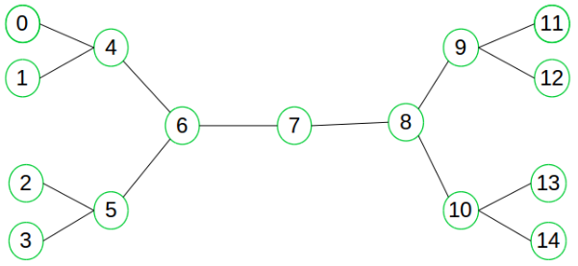
Consider the following graph
Suppose we want to find if there exists a path from vertex 0 to vertex 14.
Here we can execute two searches, one from vertex 0 and other from vertex 14.
When both forward and backward search meet at vertex 7, we know that we have found a path from node 0 to 14 and search can be terminated now.
We can clearly see that we have successfully avoided unnecessary exploration.

Slide 40
Why bidirectional approach?
Because in many cases it is faster, it dramatically reduce the amount of required exploration. Suppose if branching factor of tree is b and distance of goal vertex from source is d, then the normal BFS/DFS searching complexity would be O(b^{d}).
On the other hand, if we execute two search operation then the complexity would be O(b^{d/2}) for each search and total complexity would be O(b^{d/2} +b^{d/2}) which is far less than O(b^{d}).
When to use bidirectional approach?
We can consider bidirectional approach when-
Both initial and goal states are unique and completely defined.
The branching factor is exactly the same in both directions.

Slide 41
Performance measures
Completeness : Bidirectional search is complete if BFS is used in both searches.
Optimality : It is optimal if BFS is used for search and paths have uniform cost.
Time and Space Complexity : Time and space complexity is O(b^{d/2}).

Slide 42
Assignment 2
Using case studies or theoretical scenarios, write structured essays (max 8 pages total) addressing:
Supervised vs Unsupervised Learning — Analyze their strengths and weaknesses; illustrate with suitable examples.
Deep Learning — Explain its theoretical underpinnings and why it marks a shift in AI.
Reinforcement Learning — Outline its learning cycle (agent, environment, reward) with a relatable analogy.
Ontology — Define and explain its importance in knowledge structuring; give a relevant example.
Decision Trees — Critically evaluate their role as interpretable AI models compared with black-box models.
Bias-Variance Tradeoff & Overfitting vs Underfitting — Discuss these as central challenges in ML, explaining their impact on model generalization and practical deployment.
No Free Lunch Theorem — Briefly analyze why no single model performs best across all problems, and link this to model selection in practice.

Slide 43
Rules of Engagement for Assignment 2
To be hand-written on A4-size papers of not more than the specified number of pages (max 8) and properly stapled
All assignments must include:
Class Number/ (Group)
Date
Matric Number
Program of Study.
Exclude names. Non-compliance = –2 marks.

Slide 44
We will look at Informed Search after your mid semester examination next week

Slide 45
Lab Practical for the week (21/10/2025)
Implementation of the 8-puzzle game
Solve using BFS, DFS, DLS, Iterative Deepening (IDS), and Bidirectional Search
Compares execution time, number of nodes expanded, solution length, and optimality/completeness
Notes:
Copy and paste the code given on google colab

Slide 46
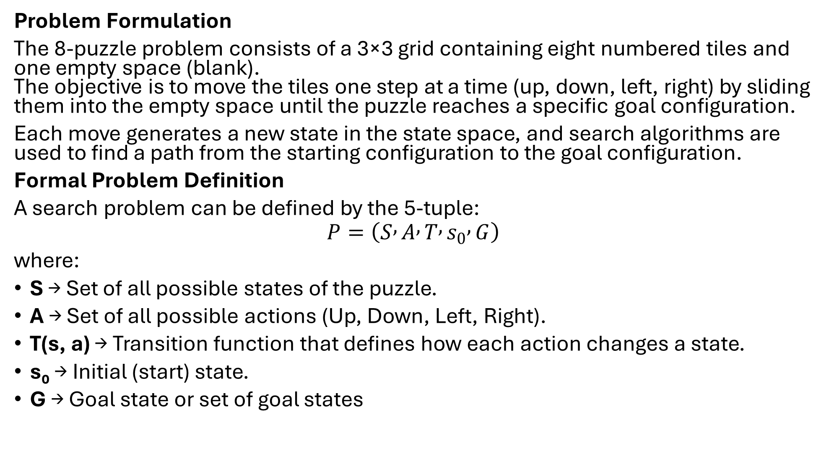
Problem Formulation
The 8-puzzle problem consists of a 3×3 grid containing eight numbered tiles and one empty space (blank). The objective is to move the tiles one step at a time (up, down, left, right) by sliding them into the empty space until the puzzle reaches a specific goal configuration.
Each move generates a new state in the state space, and search algorithms are used to find a path from the starting configuration to the goal configuration.
Formal Problem Definition
A search problem can be defined by the 5-tuple:
$$P=\left(S , A , T , s_{0} , G\right)$$
where:
S → Set of all possible states of the puzzle.
A → Set of all possible actions (Up, Down, Left, Right).
T(s, a) → Transition function that defines how each action changes a state.
s₀ → Initial (start) state.
G → Goal state or set of goal states

Slide 47
Start State (s₀)
In the code, the start state is represented as a tuple:
start_state = (1, 2, 3,
4, 0, 6,
7, 5, 8)
This corresponds to the following board layout:
1 2 3
4 _ 6
7 5 8
Here, 0 represents the blank tile (empty space).

Slide 48
Goal State (G)
The target configuration is defined as:
goal_state = (1, 2, 3,
4, 5, 6,
7, 8, 0)
Which represents:
1 2 3
4 5 6
7 8 _
The objective of all algorithms is to reach this configuration from the start state through a sequence of valid moves.

Slide 49
Transition Function (T(s, a))
In the code, the transition function is implemented in the get_neighbors(state) function:
def get_neighbors(state):
neighbors = []
idx = state.index(0) # blank tile
row, col = divmod(idx, 3)
moves = [(-1,0), (1,0), (0,-1), (0,1)] # Up, Down, Left, Right
for dr, dc in moves:
new_row, new_col = row + dr, col + dc
if 0 <= new_row < 3 and 0 <= new_col < 3:
new_idx = new_row * 3 + new_col
new_state = list(state)
new_state[idx], new_state[new_idx] = new_state[new_idx], new_state[idx]
neighbors.append(tuple(new_state))
return neighbors

Slide 50
From the code;
Input: The current state (a tuple of length 9).
Process:
Locate the blank tile (0).
Determine valid moves (Up, Down, Left, Right).
Swap the blank tile with the adjacent tile for each valid move.
Return all resulting states as possible next states.
Output: A list of new states reachable from the current one in a single move.

Slide 51
Path Cost Function
In this code:
Each move has an equal cost of 1.
Therefore, the total path cost = number of moves from start to goal.
(In BFS and IDS, this ensures the algorithm finds the optimal path—the shortest sequence of moves.)
Goal Test
The goal test checks whether the current state equals the goal configuration:
if node == goal:
return path
This terminates the search and returns the successful path once the goal is found.

Slide 52
Output result on google colab
Running BFS... Execution Time: 0.0001s Nodes Expanded: 8 Solution Length: 2 Final State: (1, 2, 3) (4, 5, 6) (7, 8, 0) ================================================== Running DFS... Execution Time: 0.0002s Nodes Expanded: 47 Solution Length: 30 Final State: (1, 2, 3) (4, 5, 6) (7, 8, 0) ================================================== Running DLS (limit=10)... Execution Time: 0.0009s Nodes Expanded: 448 Solution Length: 2 Final State: (1, 2, 3) (4, 5, 6) (7, 8, 0) ================================================== Running IDS... Execution Time: 0.0000s Nodes Expanded: 13 Solution Length: 2 Final State: (1, 2, 3) (4, 5, 6) (7, 8, 0) ================================================== Running Bidirectional... Execution Time: 0.0000s Nodes Expanded: 1 Solution Length: 1 Final State: (1, 2, 3) (4, 5, 6) (7, 0, 8)

Slide 53
Practical questions (Ensure to do this for your own sake)
Question 1: Algorithm Behavior Comparison
Task: Run the 8-puzzle solver using BFS, DFS, DLS, IDS, and Bidirectional Search on the same start and goal states.
Instructions:
Record the number of steps (path length), number of nodes expanded, and time taken by each algorithm.
Present your results in a comparison table.
Question:
Which of these algorithms found the shortest path?
Which algorithm took the longest time, and why?

Slide 54
Question 2: Optimality and Completeness
Task: Modify the start state so that the puzzle is more difficult to solve, for example:
start_state = (1, 3, 4,
8, 6, 2,
7, 0, 5)
Then re-run all algorithms.
Question:
Which of the algorithms are complete (i.e., guaranteed to find a solution if it exists)?
Which are optimal (i.e., guaranteed to find the shortest path)?
Explain your observations based on their search strategies (tree traversal order and path cost).

Slide 55
Question 3: Depth Limit Experiment (for DLS)
Task: Experiment with different depth limits (e.g., 5, 10, 15, 20) for the Depth-Limited Search algorithm.
Question:
What happens when the depth limit is too small?
What happens when the limit is too large?
How does Iterative Deepening Search (IDS) overcome this limitation?

Slide 56
Question 4: Visualize and Explain Search Frontier
Task: Print or visualize the frontier (open list) and visited nodes (closed list) for BFS and DFS at each iteration.
Question:
Describe how the search frontier grows differently in BFS vs DFS.
Why does BFS consume more memory than DFS?
How does this difference affect their space complexity?

Slide 57
Question 5: Design and Extension Challenge
Task: Extend the code to include Uniform Cost Search (UCS) and A* Search for the same 8-puzzle problem. Use a simple heuristic function such as Misplaced Tiles or Manhattan Distance.
Question:
Compare the performance of your A* implementation to BFS and IDS.
How does the heuristic improve efficiency?
Is A* both complete and optimal? Under what conditions?

Slide 58
Note that this project will be checked and assessed on each student’s laptop at any chosen time by the assessor.

